Slide 1


Morris Training
Section 2
1) Client Field Creation
2) Job Creation

Slide 2
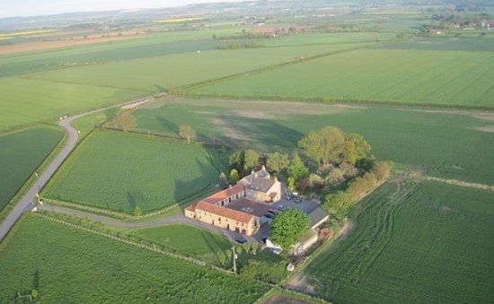
Client Field Creation
Client Name
Farm Name
Field Name

Slide 3

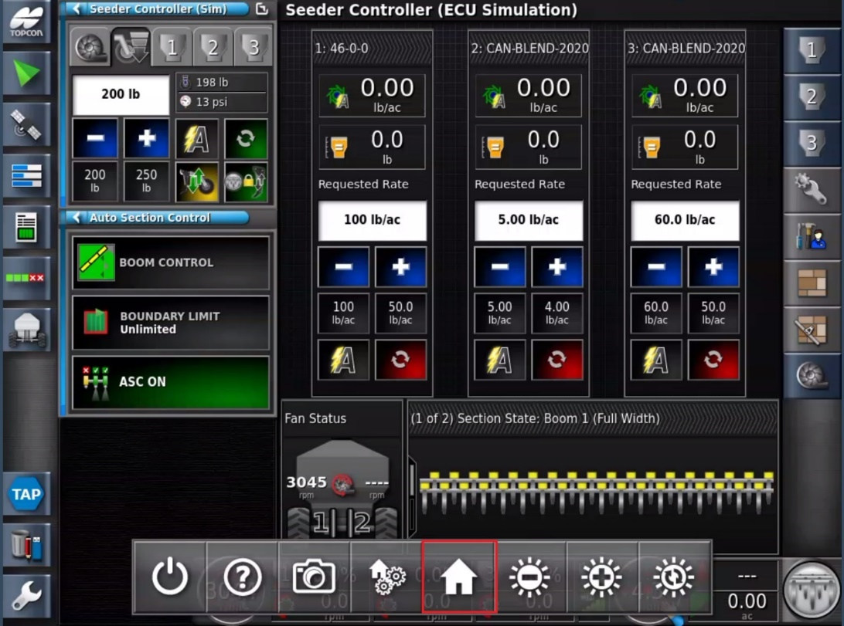
Swipe up and press the
Home
icon, to access the Global home screen menu at any time
Swipe up and press the

Slide 4
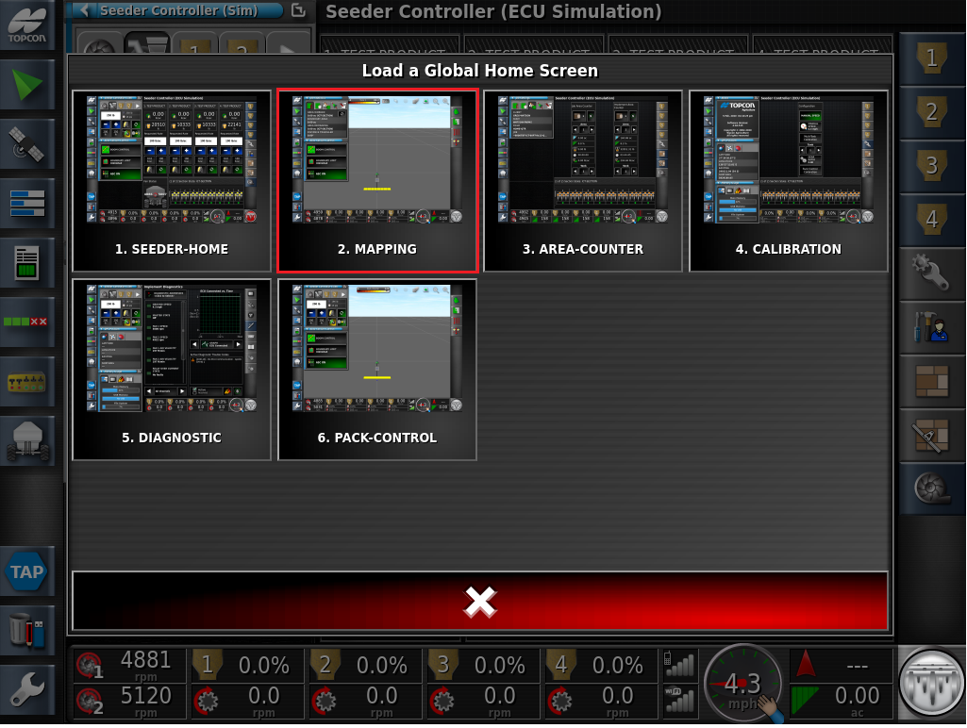
Select MAPPING

Slide 5
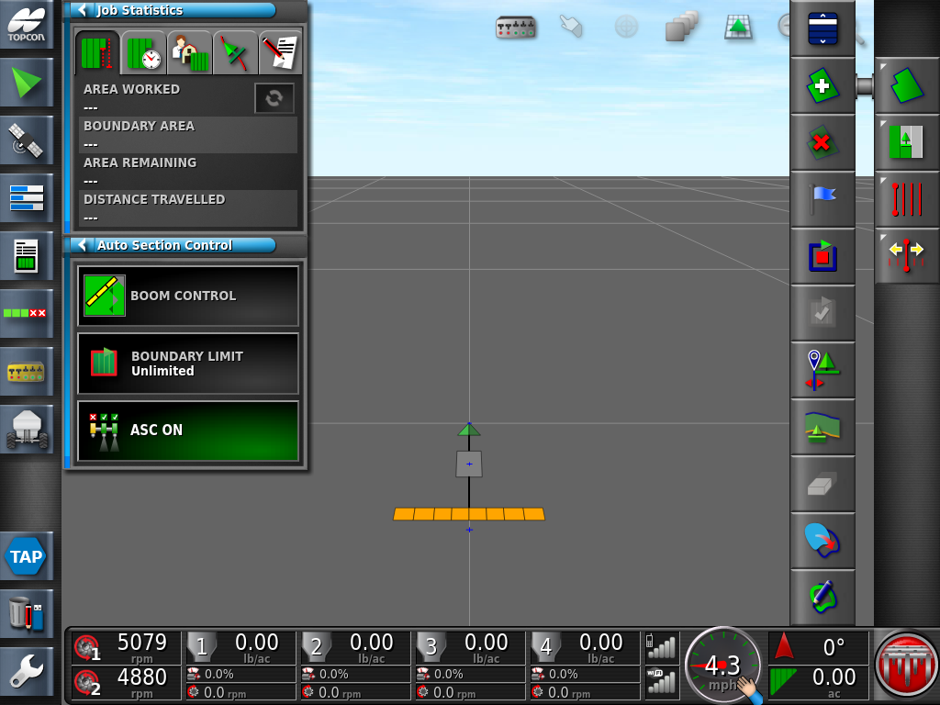


Note: The implement will only appear on the screen if the GPS is configured properly
.
Press the Field Menu icon followed by the Create New Field icon
.

Slide 6
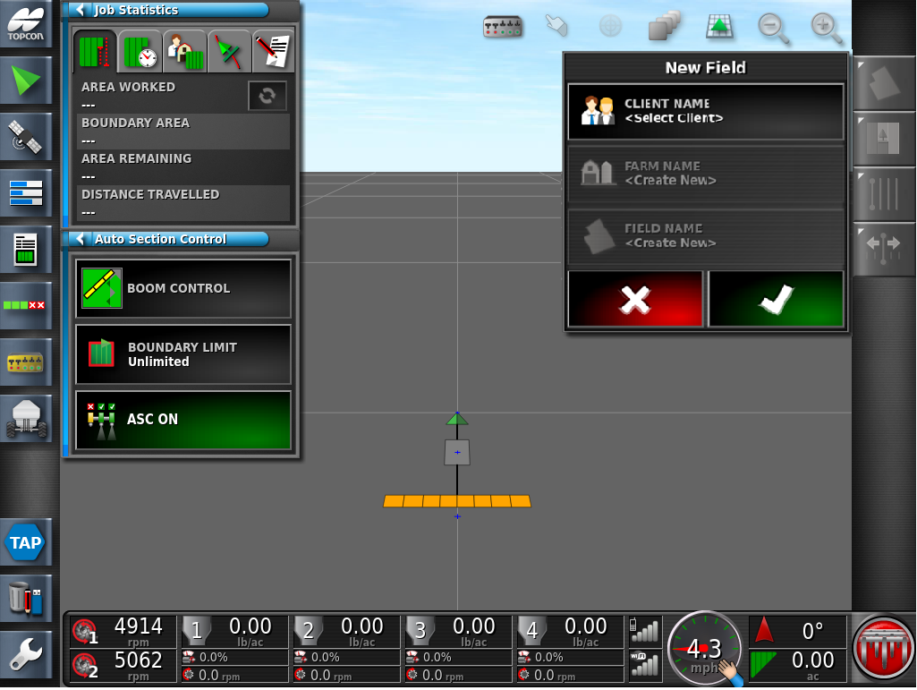
Press the Client Name Icon

Slide 7
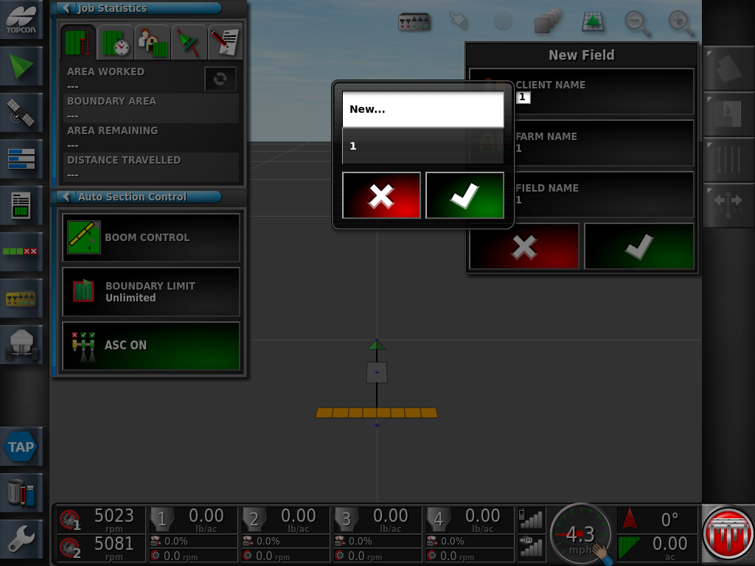
Select New… Apply the setting with the Green Check Mark

Slide 8
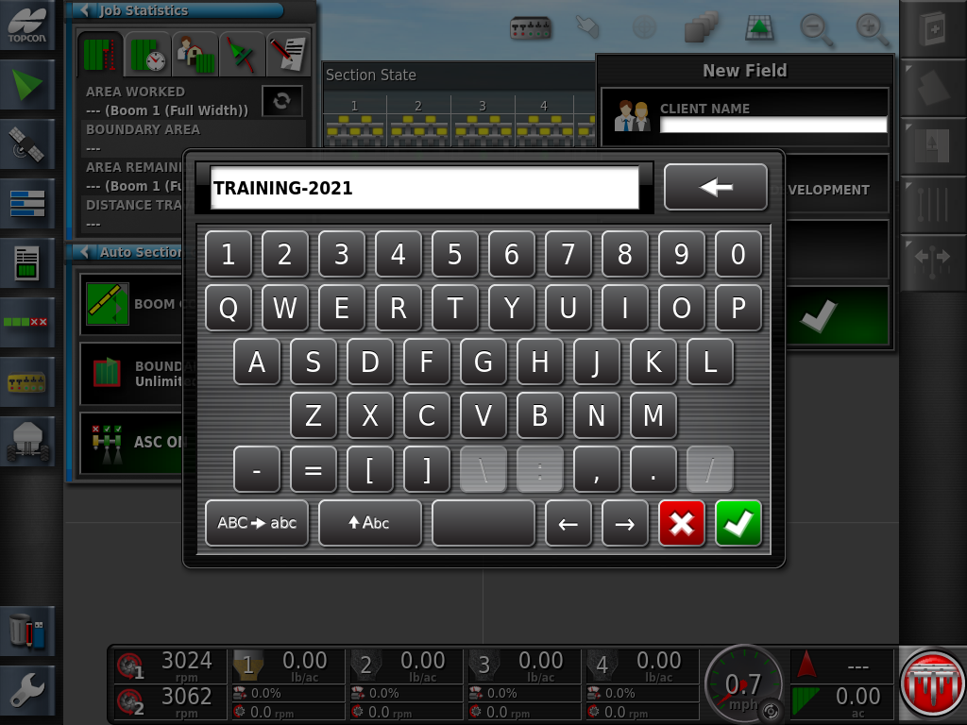
Enter a Name for the Client. Always use – no spaces

Slide 9
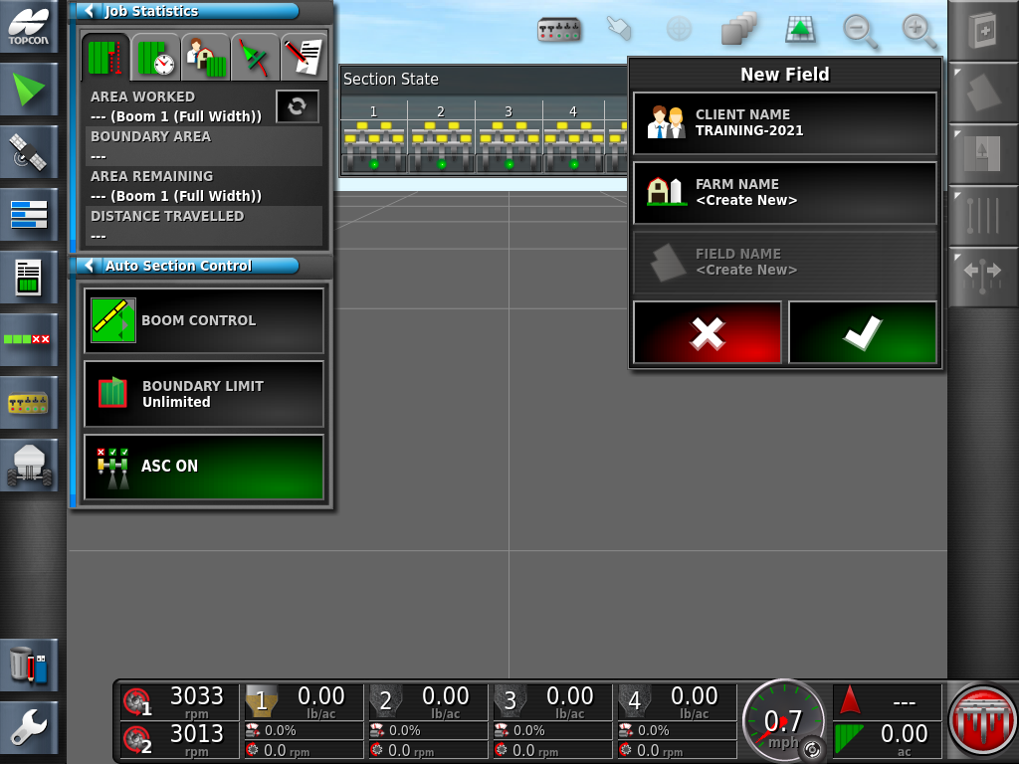
Press on the Farm Name <Create New> Icon

Slide 10
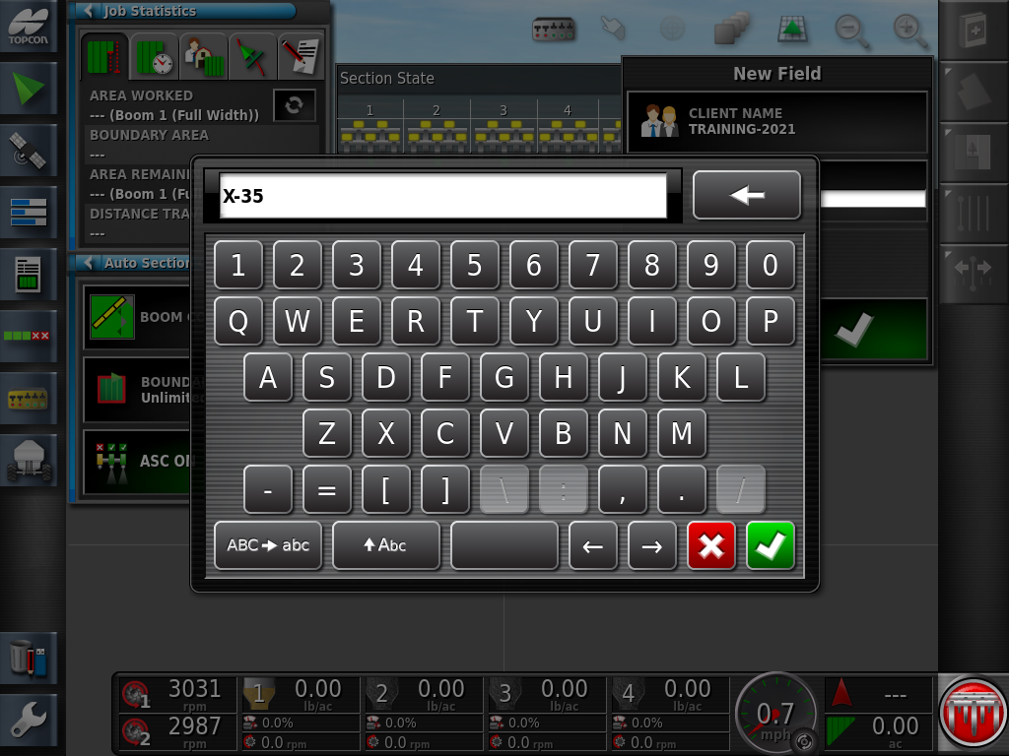
Enter the Farm Name. Apply the setting with the Green Check Mark

Slide 11
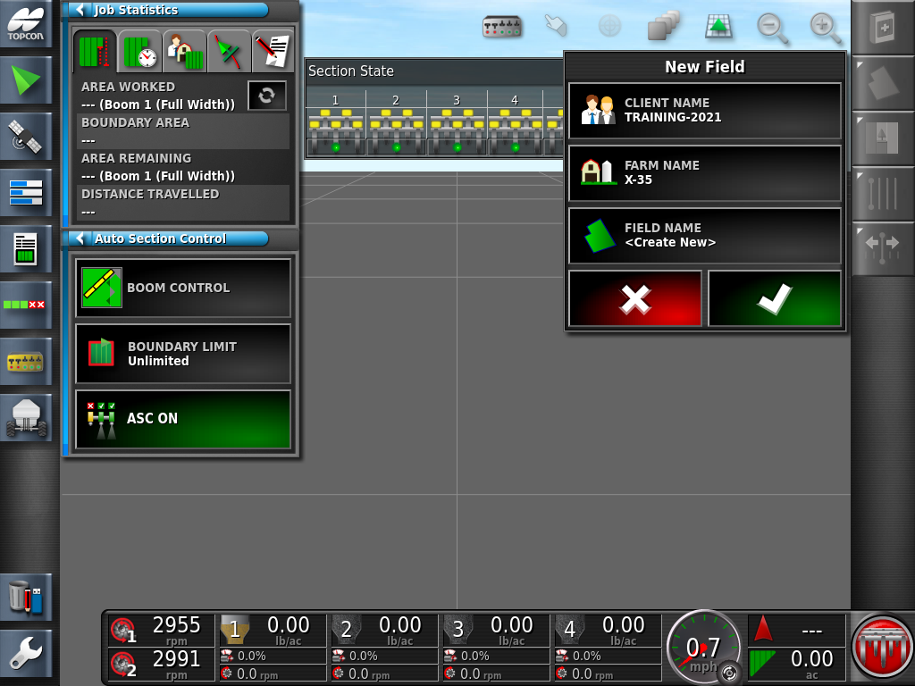
Press on the Field Name <Create New> Icon

Slide 12
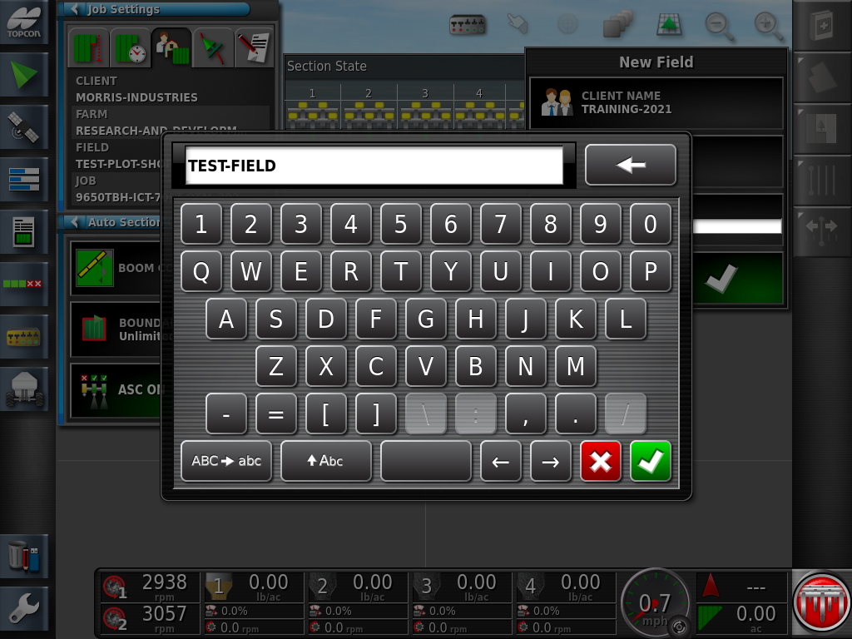
Enter the name of your first field.(ex. TEST-FIELD) Apply the setting with the Green Check Mark

Slide 13
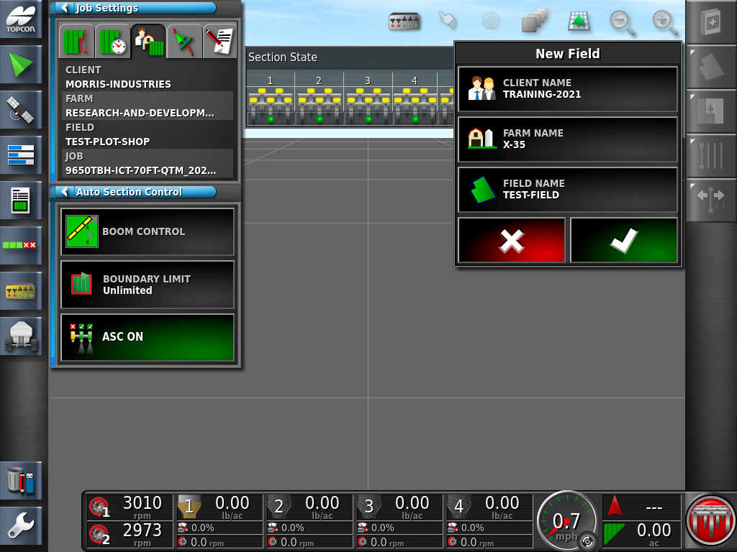
NOTE THIS WINDOW!!
Review the information you entered, apply and save the changes with the Green check mark. Once the Green check mark is pressed the field information has been saved.

Slide 14
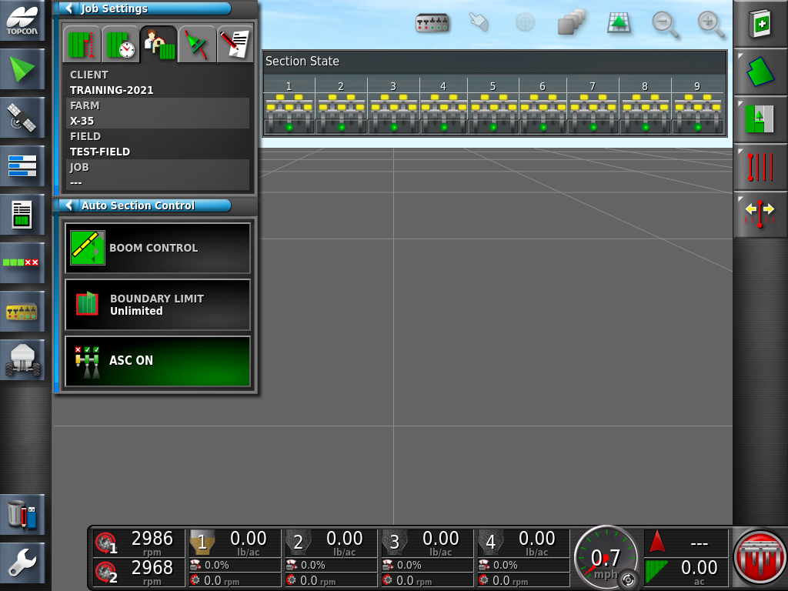
To confirm saved information check Job Information window.
Press Job Settings Icon

Slide 15

Now that you have created a Field Name. You can go ahead and enter the rest of your Field Names. This will save you time when you are ready to seed.
N55030 X35 110v Power Desktop Adapter- This will make it so you can take your X35 into your home and add all user information from the comfort of your office.

Slide 16

Select Field icon
Once you are finished entering your fields Press the Select Field Icon

Slide 17
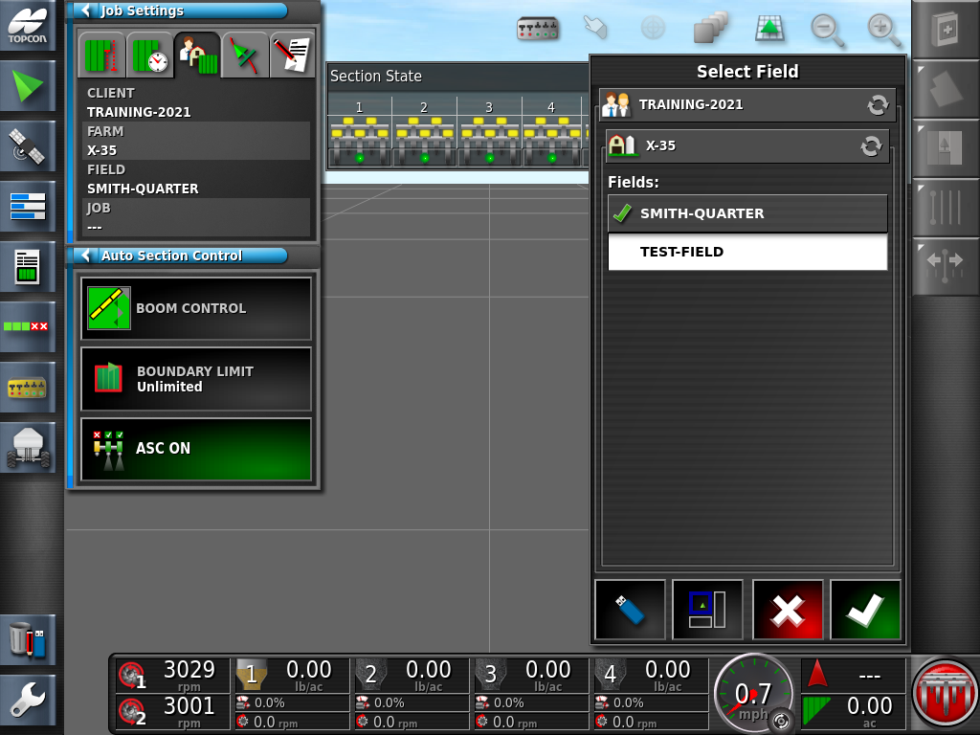
The fields you created are in the list. Notice how the last field you created has the Green Check Mark beside it. Select the Field you wish to seed first. Press the Green Check mark to activate that field.

Slide 18
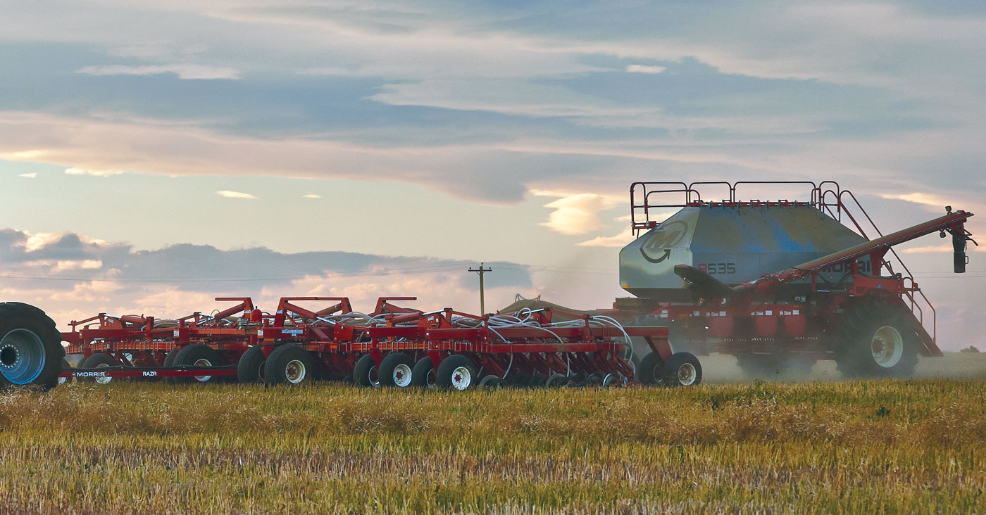
Job Creation

Slide 19

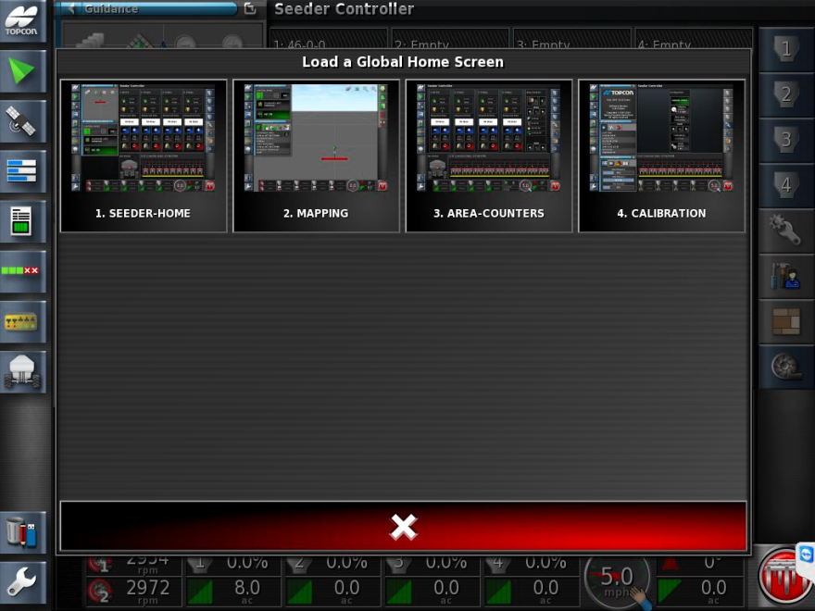
Swipe up from bottom of screen Select GLOBAL HOME SCREEN
Select- MAPPING

Slide 20
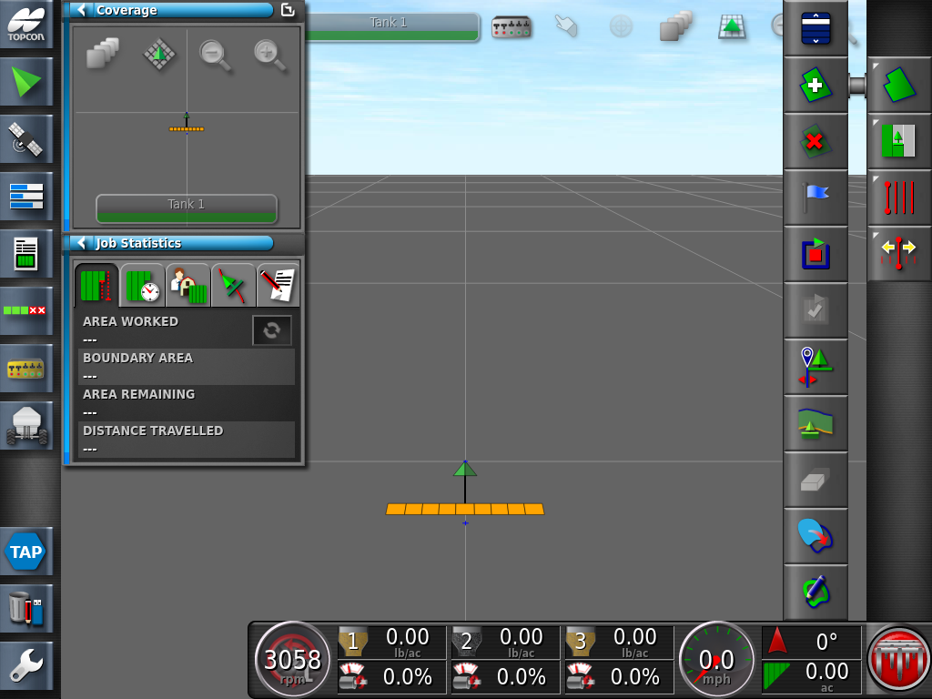

Open the Field Menu icon
Followed by the Select Field

Slide 21
Select the Field followed by the Green Check mark to apply the settings.

Slide 22
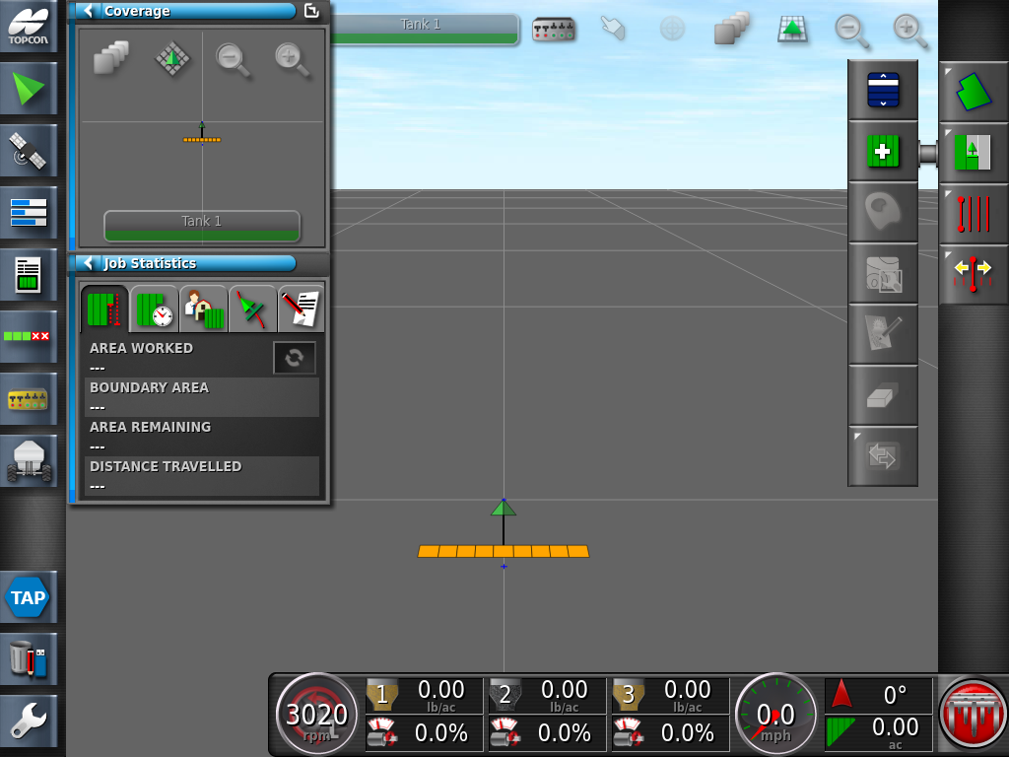


Press the Job menu icon
Followed by the Create New Job icon

Slide 23
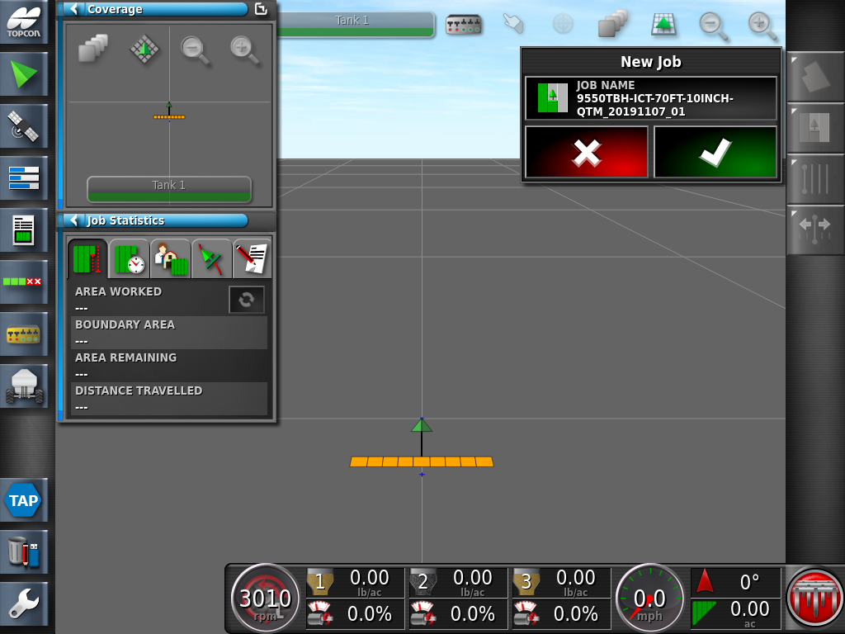
The system will automatically generate a new Job name based on the date.
You can proceed to use the default name by pressing the green check mark.
However, the Job Name can be edited by simply pressing in the job name window.

Slide 24
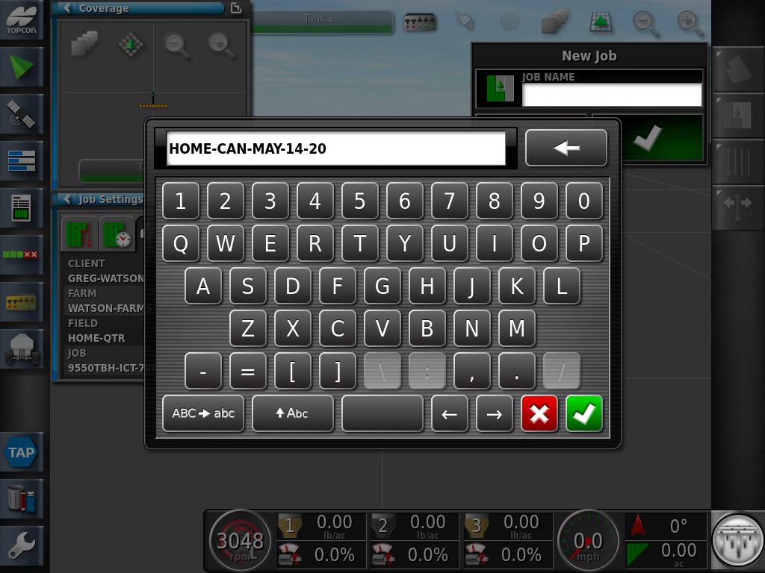
It is recommended to edit job name to match the current Date and Product used.
Example: CANOLA-MAY-15-2021; apply the settings with the Green Check mark
CANOLA-MAY-15-2021

Slide 25
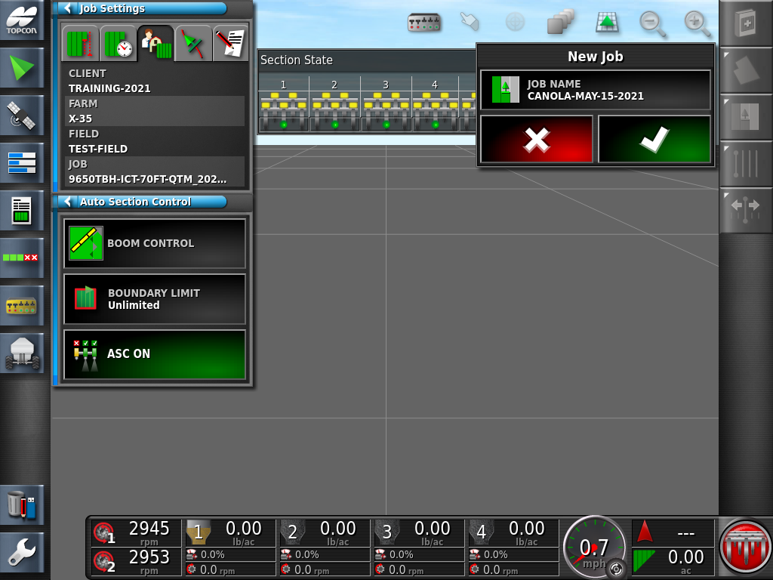
Confirm the Job Name with the Green Check mark

Slide 26
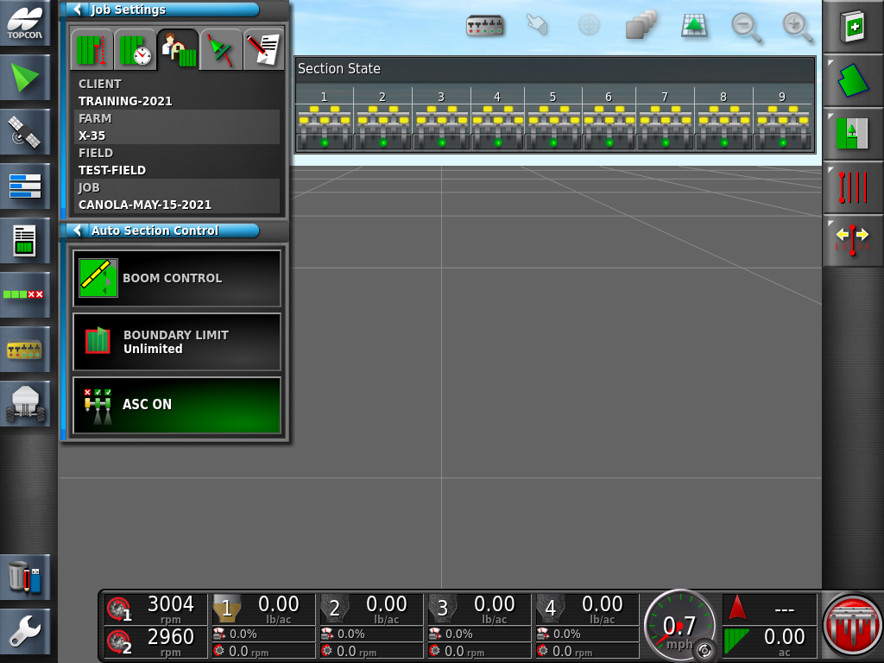
Press the Job Setting on the Job Statistics mini view to review that the Client, Farm, Field and Job information is correct.

