Slide 1



Morris Training
Section 3
Creating a Product
Adding Products to Tank

Slide 2
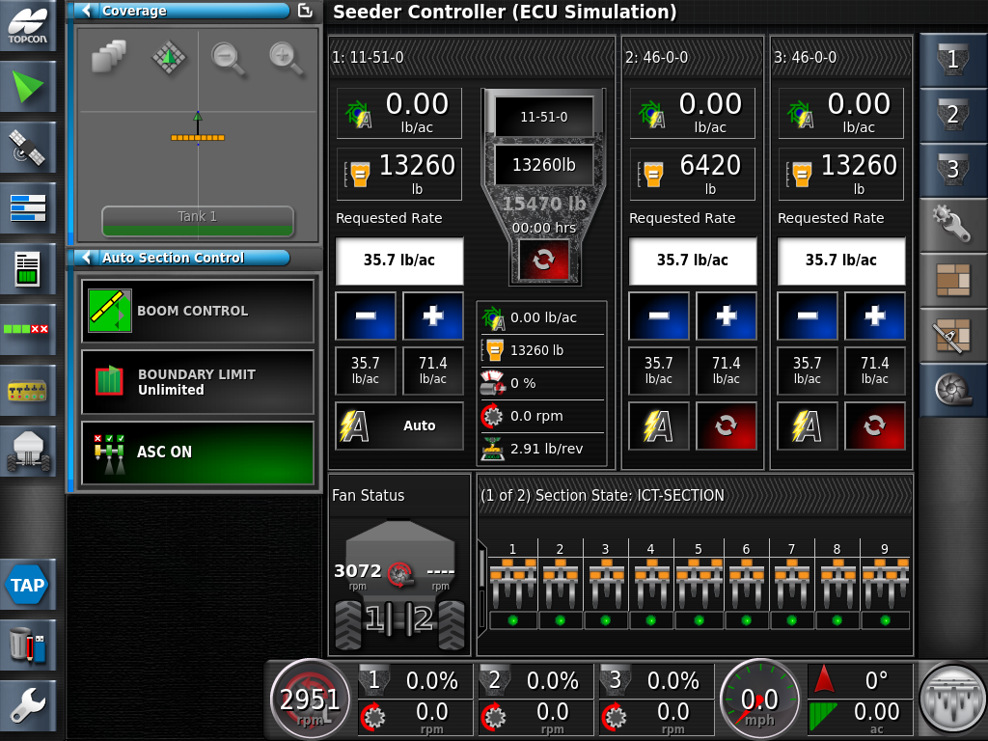
Press on the Top area of the Tank- to open the Product Configuration Window Note: You must have the Tank fully expanded.

Slide 3
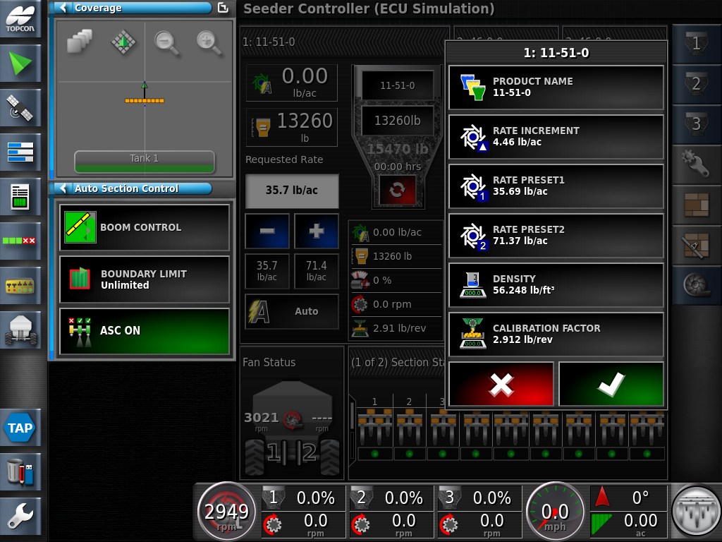
Press on the Product Name Window

Slide 4
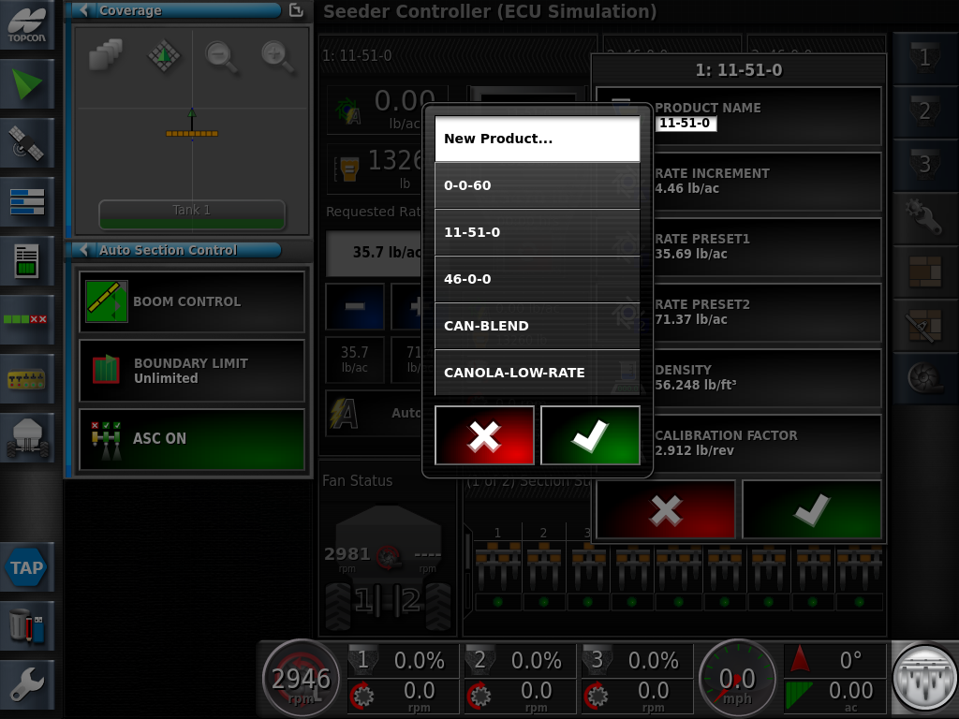
Select New Product and Hit the Green Check Mark

Slide 5
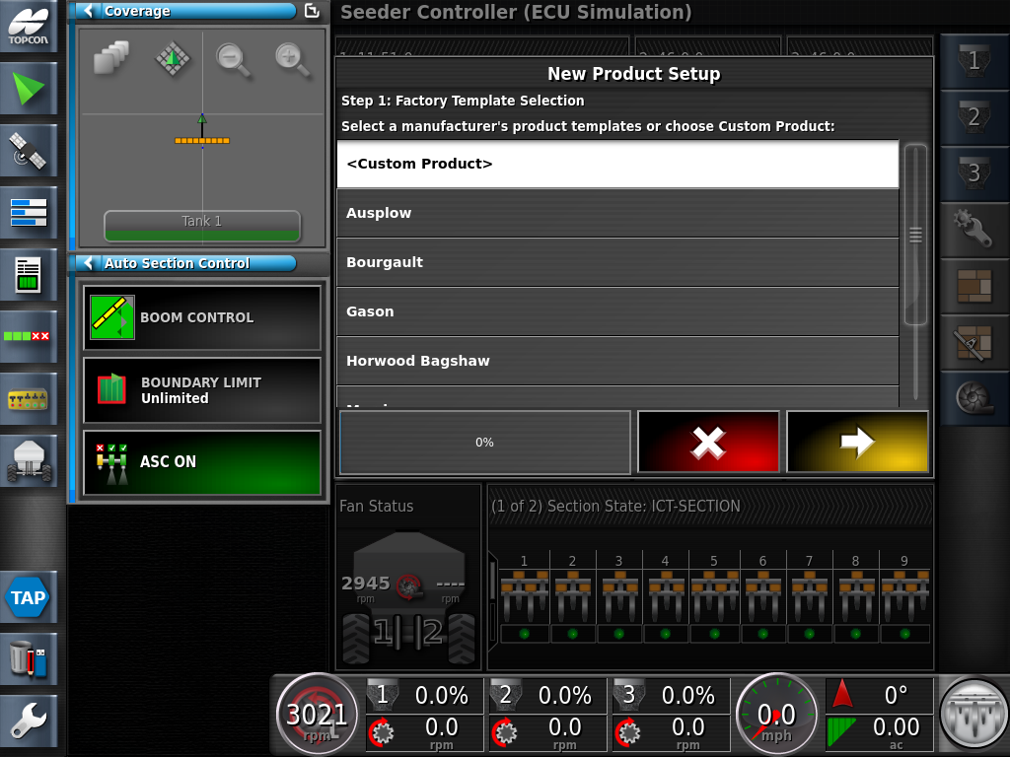
Chose Custom Product, proceed by pressing the Yellow Forward Arrow after each step

Slide 6
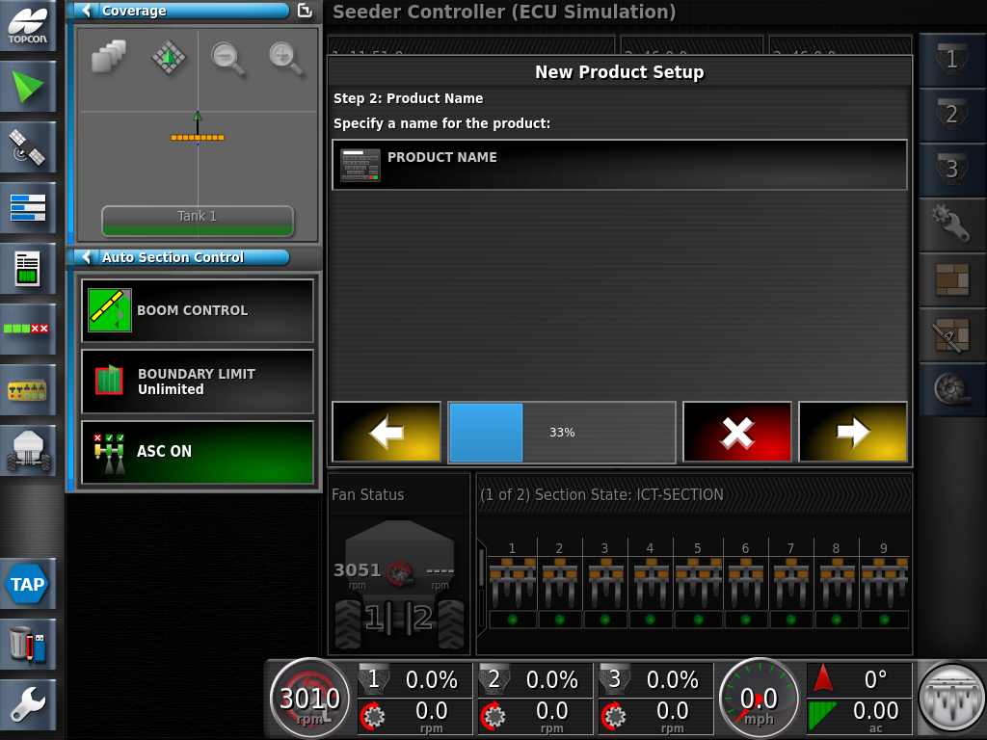
Tap on the PRODUCT NAME

Slide 7
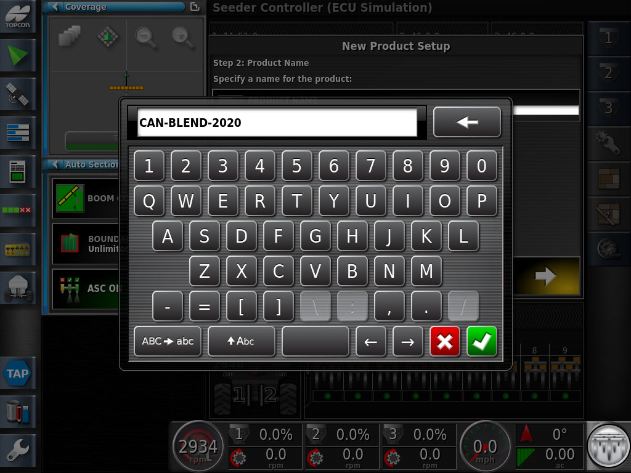
Enter a product name, as an example we are using CAN-BLEND-2020, followed by the Green Check Mark

Slide 8

Proceed with the Yellow forward arrow

Slide 9
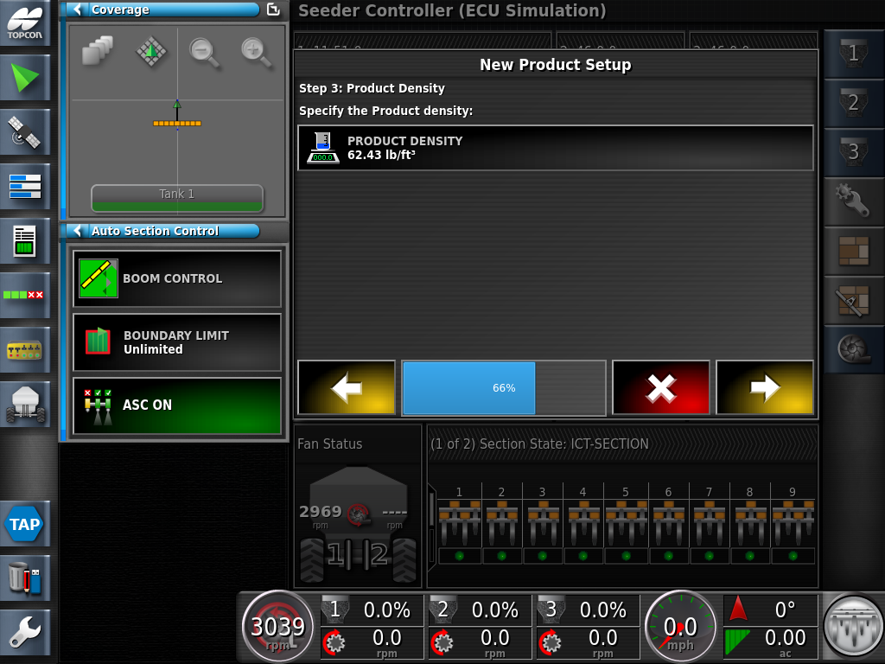
Enter the density of the Product. The density of the product can be requested From Your Seed Or Fertilizer Supplier. If a density is not available proceed with the default value.

Slide 10
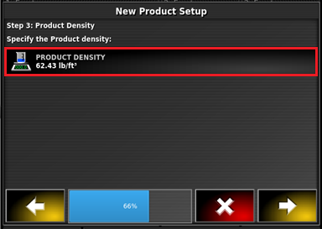
If you would like to enter the density, press on the Product Density Tab

Slide 11
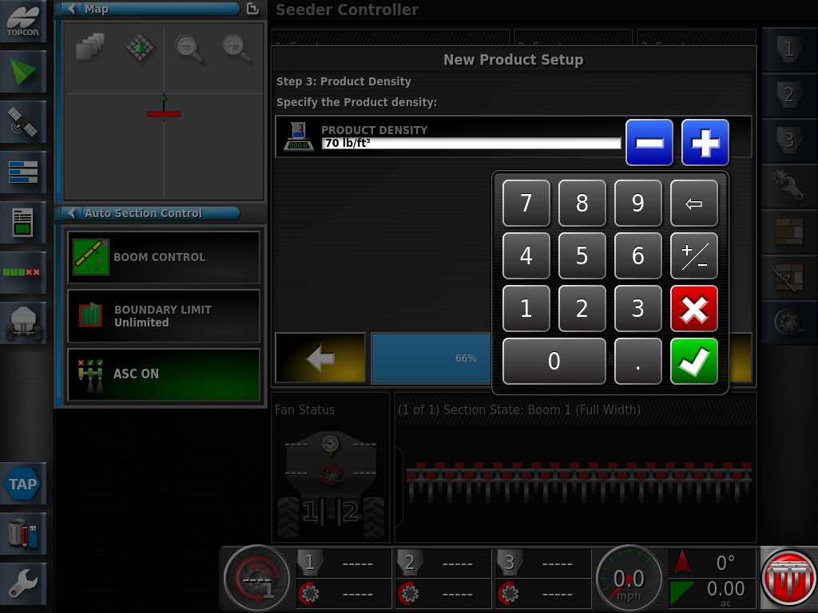
Enter the new density value from the product supplier. Followed by the Green Check Mark

Slide 12
To continue press the Yellow Arrow

Slide 13
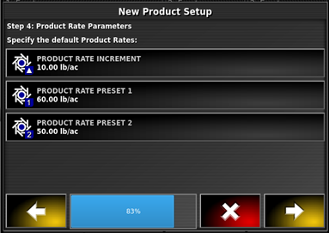
Enter Product Rate increment and Preset Rates.
Rate increment- Used for quickly bumping the rates up or down (+/-) while moving.
Preset 1 – Enter the desired rate you will be seeding at.
Preset 2 – Can be used as a secondary rate as desired, example a lower rate used on hilltops or areas of the field which do not require as much product

Slide 14
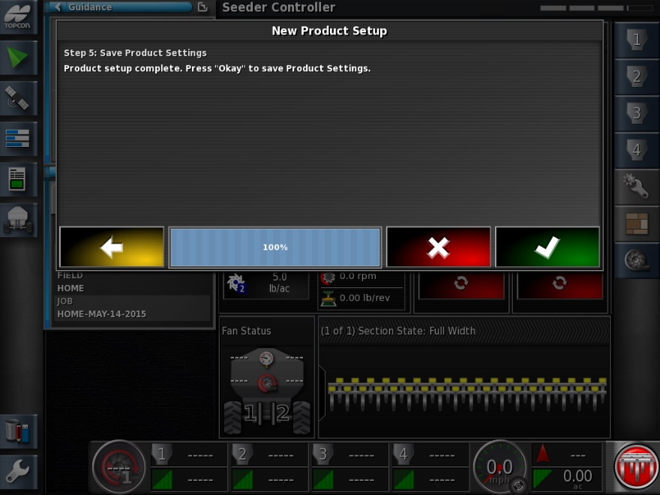
Proceed by touching the Green Check Mark

Slide 15
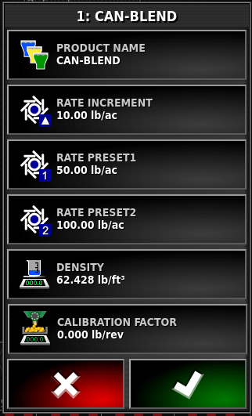
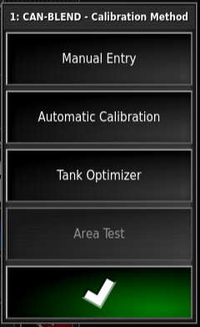
Add a generic Calibration Factor
Press Manual Entry Icon

Slide 16
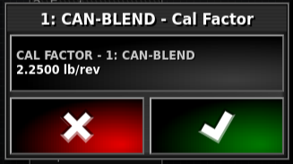
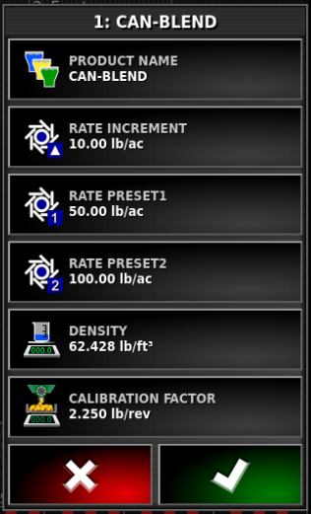
Enter a generic value of 2.25lb/ac, followed by the Green Check Mark
Review the product data, once satisfied with the values Apply with the Green Check Mark

Slide 17
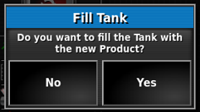
You will be prompted to Fill the Tank with the new Product. You can choose to fill the tank at this time. If you are satisfied, Click Yes

Slide 18
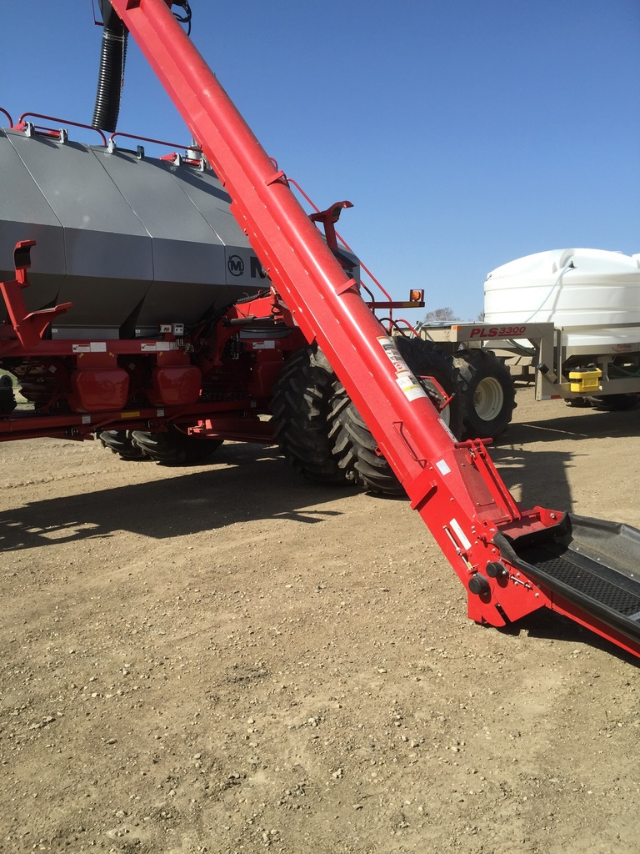
Adding Products to Tanks

Slide 19

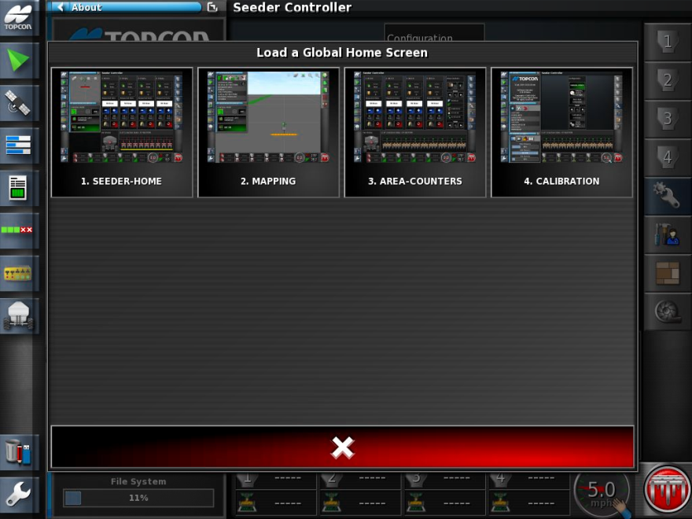
To access the Global home screen menu, Swipe up and press the
Home icon.
Select Seeder-Home

Slide 20
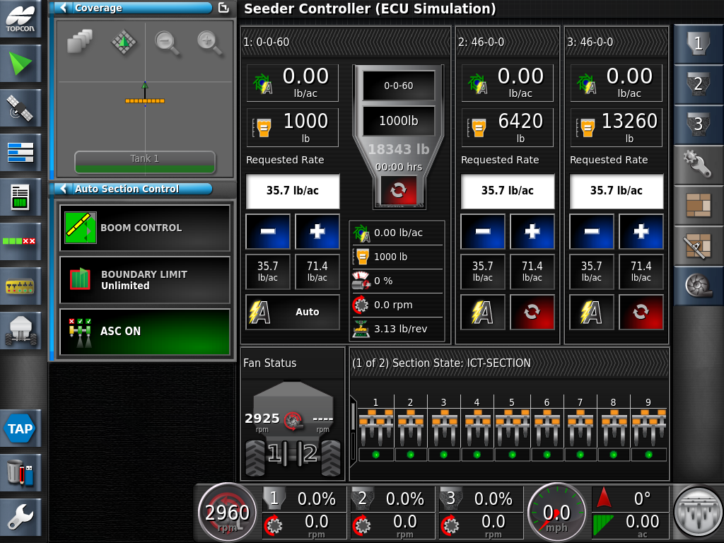
Expand the Tank you wish to add the Product into by pressing on the Title Bar

Slide 21
Press on the Top Area of the Tank – to open the Product Configuration Window

Slide 22
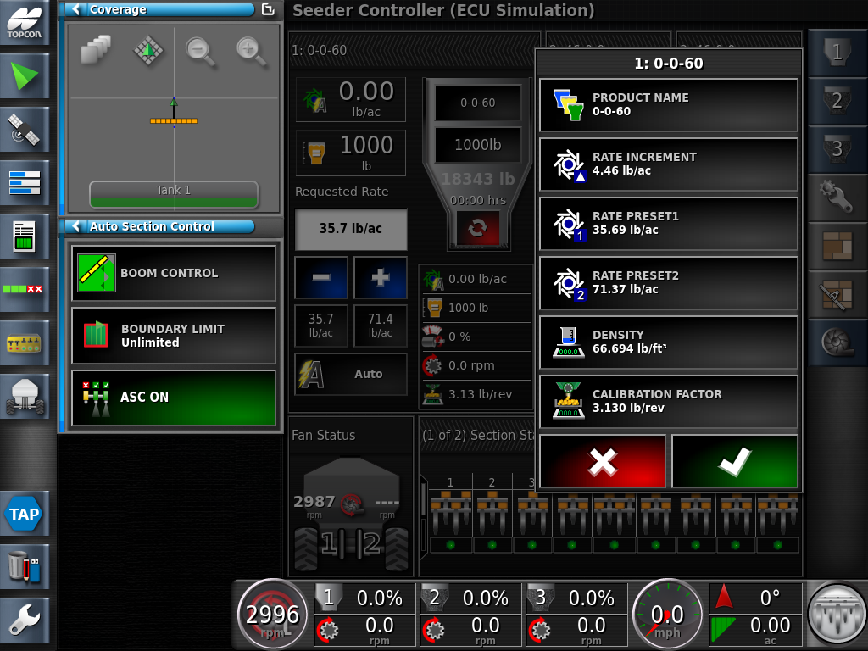
Press the Product Name <Select Product> tab

Slide 23
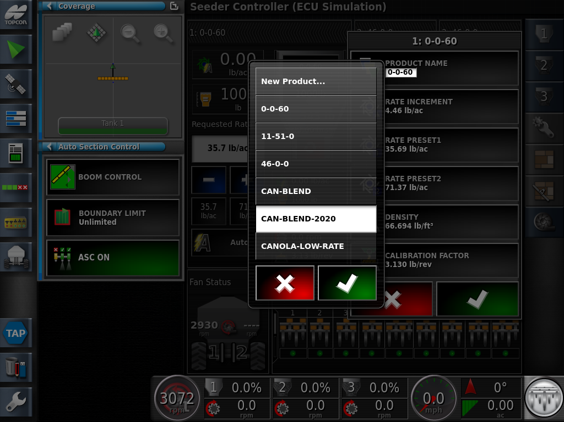
Select Product from the list. Proceed by pressing with Green check mark

Slide 24
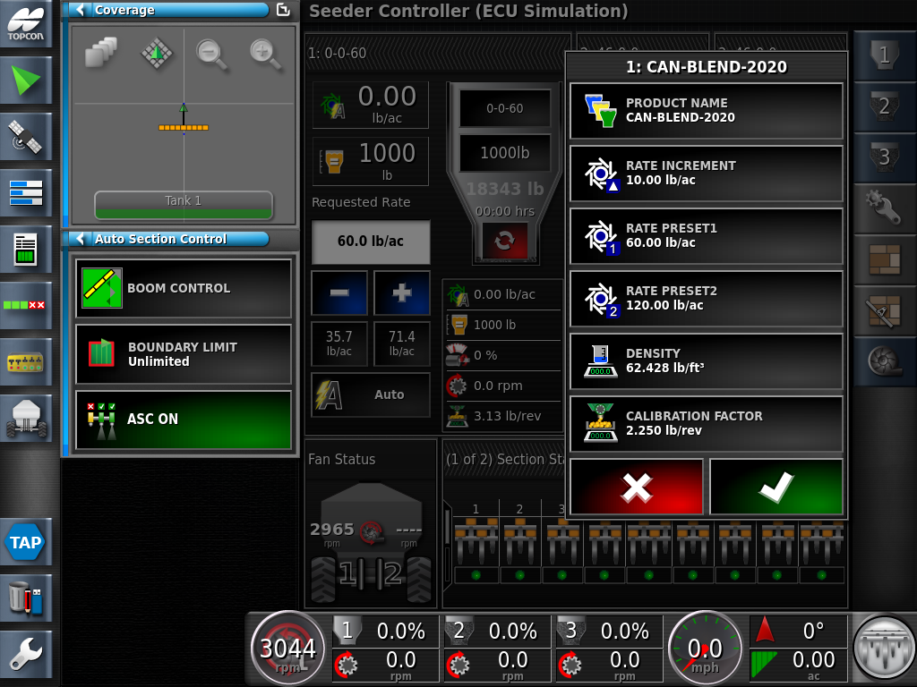
Review the Rate Presets and Rate Increment settings

Slide 25
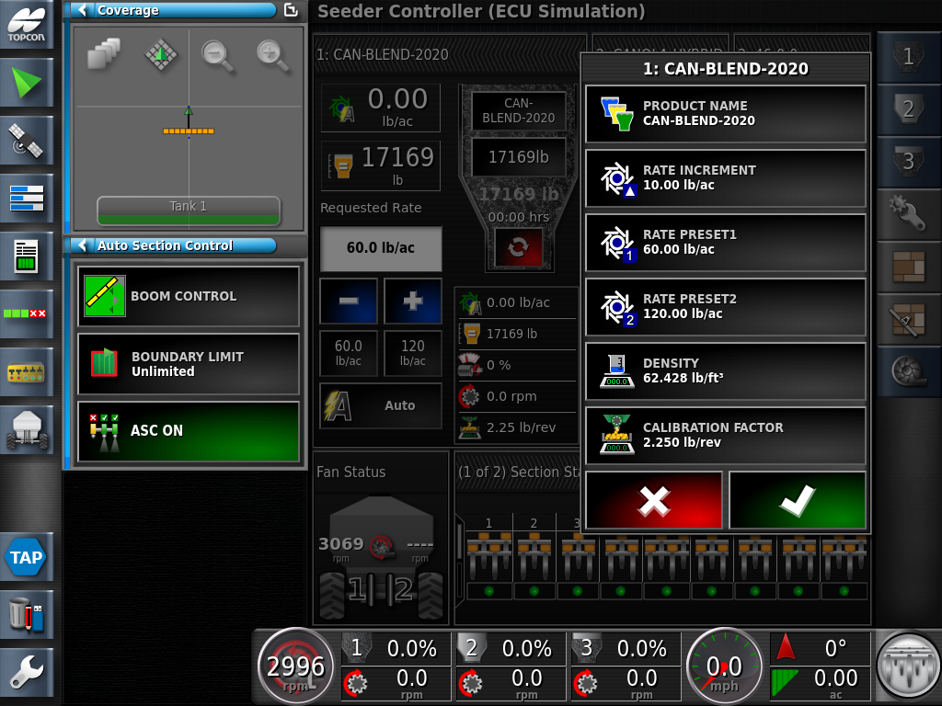
Press on the Calibration Factor window.
If this is the first time using a product adding a cal. factor will shorten calibration time.

Slide 26
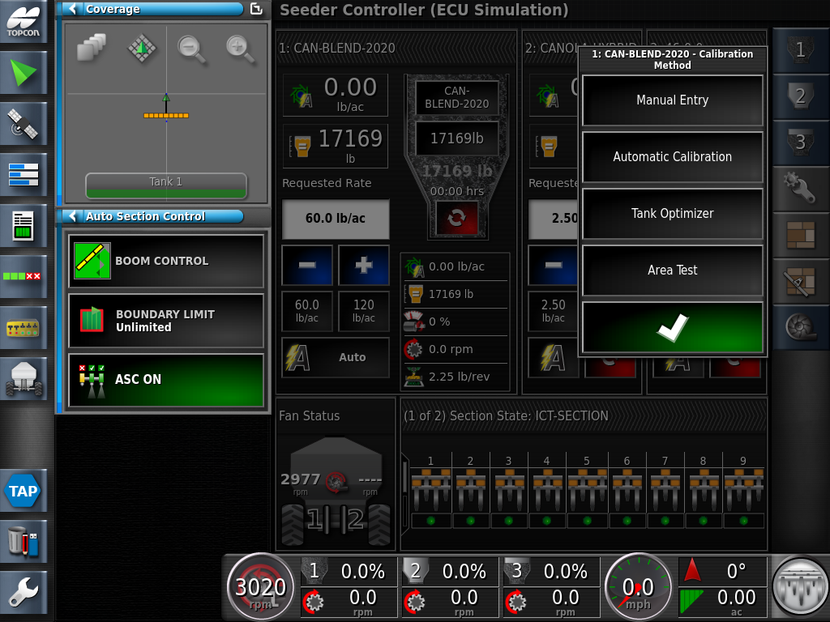
Press Manual Entry

Slide 27
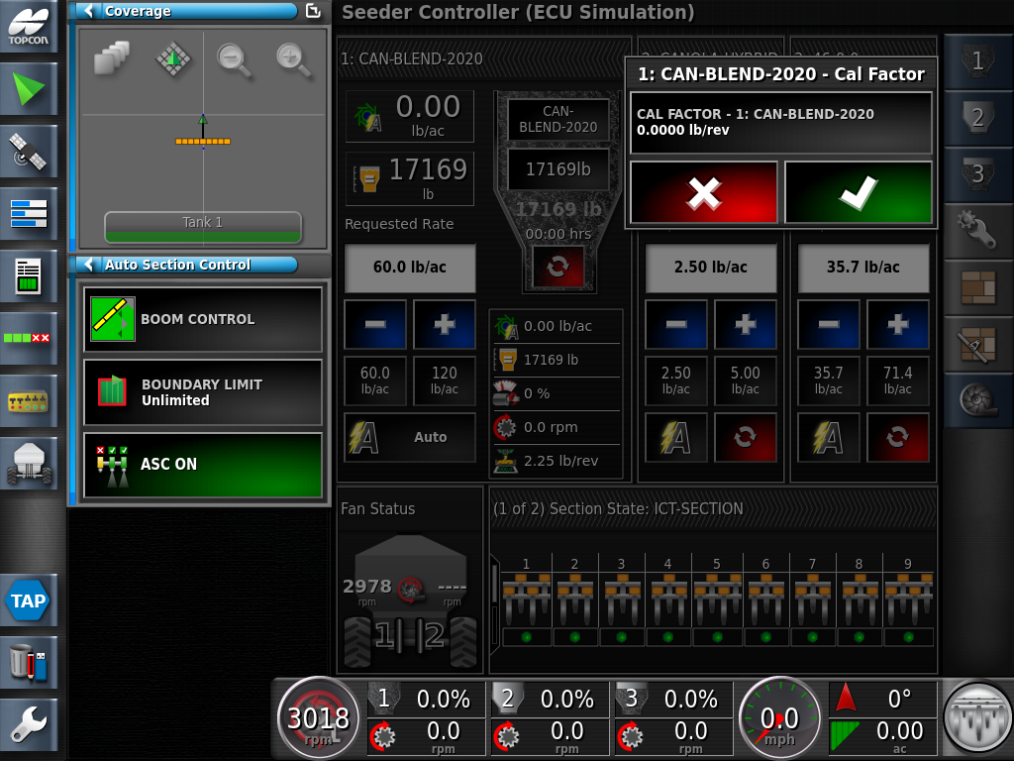
Press the Cal Factor Icon.

Slide 28
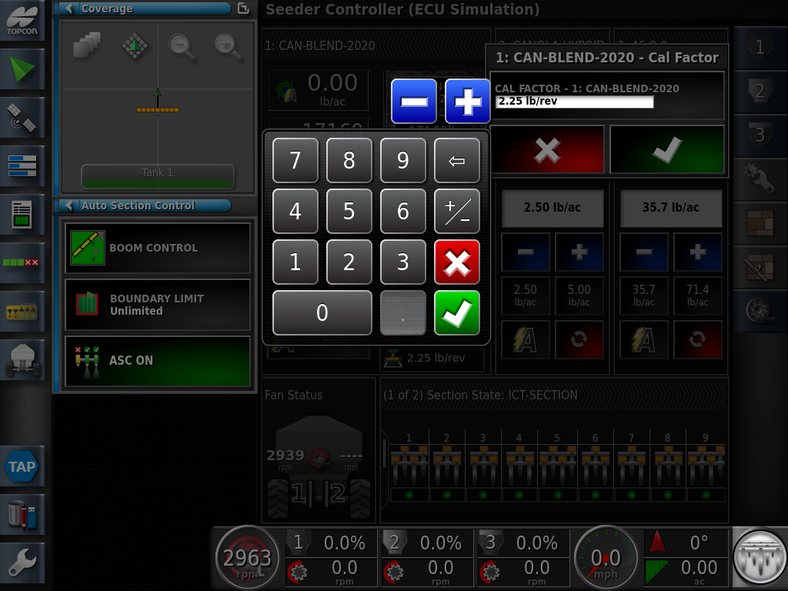
Using the keypad enter the following Cal factor 2.25 lb/Rev
Review the Cal Factor is set, press the Green Check Mark

Slide 29

Review the settings are correct press the Green Checkmark.

Slide 30
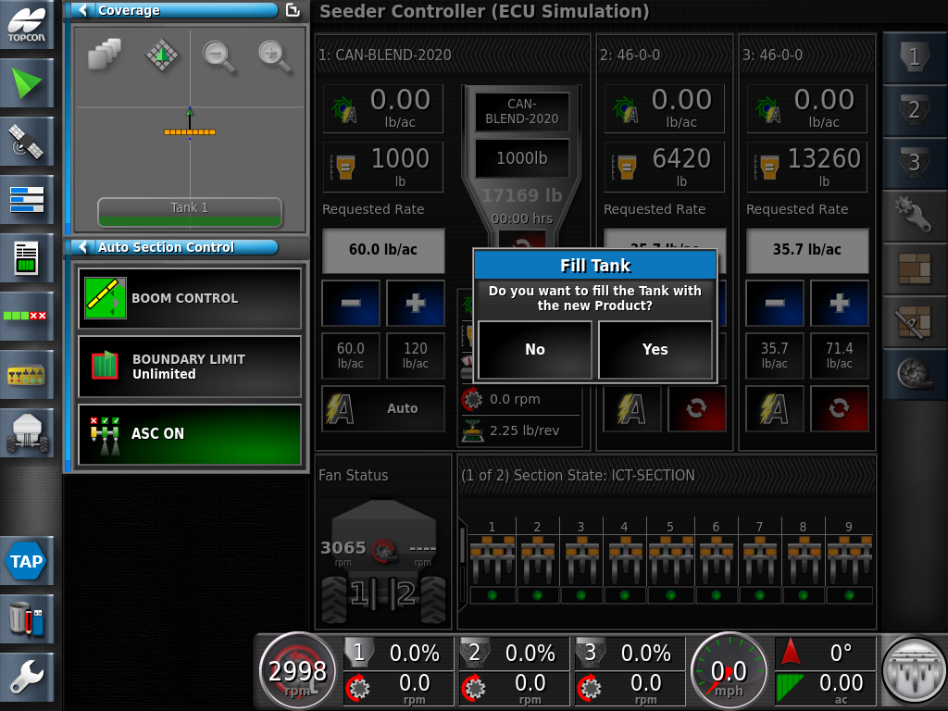
Do you want to fill the Tank with the New Product? Yes

Slide 31

Tank 1: has been filled with the desired product CAN-BLEND-2020.
Note: Preset 1 is automatically populated in the requested Rate window 60lb/ac.

Slide 32
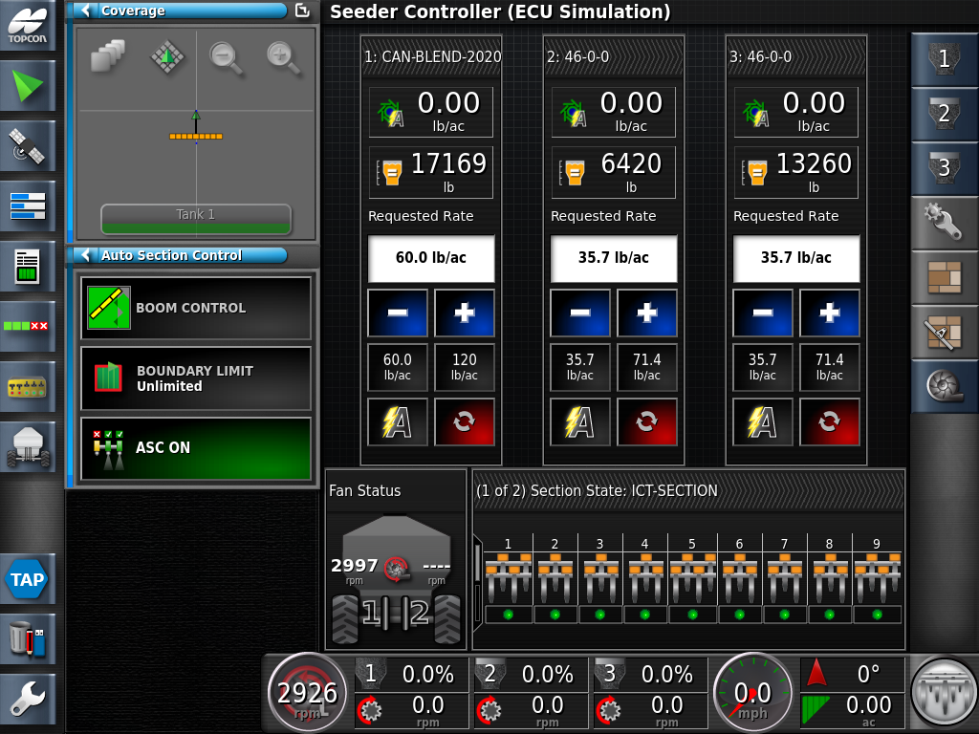
Press the Title Bar to Minimize Tank 1
Continue to fill all 4 tanks the same as you did Tank 1

Slide 33
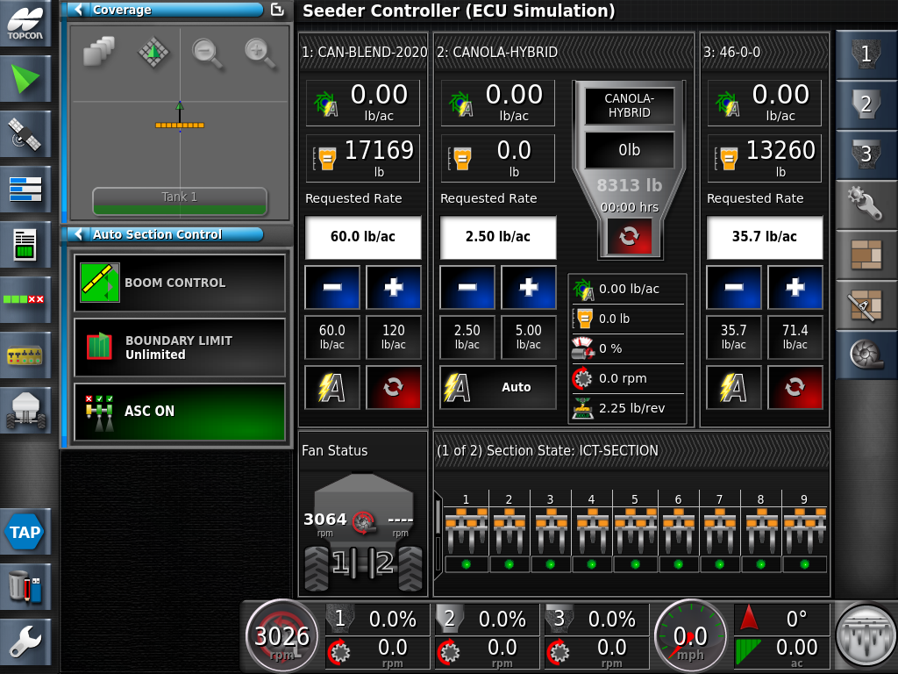
Manually Filling Tanks
With tank view expanded- Touch Tank Fill Window

Slide 34
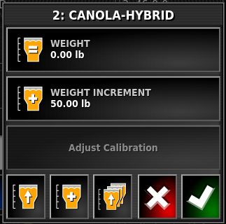
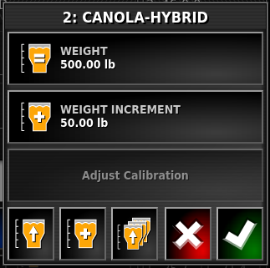
Press the Weight icon
Use this method If you know the how much the product you are using weighs
Using the keypad enter the Weight manually. Proceed by pressing the Green Check Mark

Slide 35
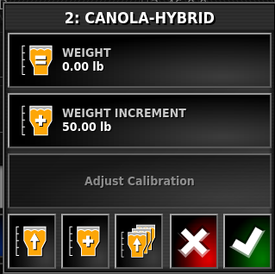

If you do not know the product weight use this method.
Touch the single “Beer” glass to fill the tank you are on
Touch the 3 “Beer” glasses to fill all tanks to capacity
NOTE: Without knowing your actual weight this method only gives you an estimate on how much product is remaining in your tanks

Slide 36
Select Green Check Mark to save

